Slide 1

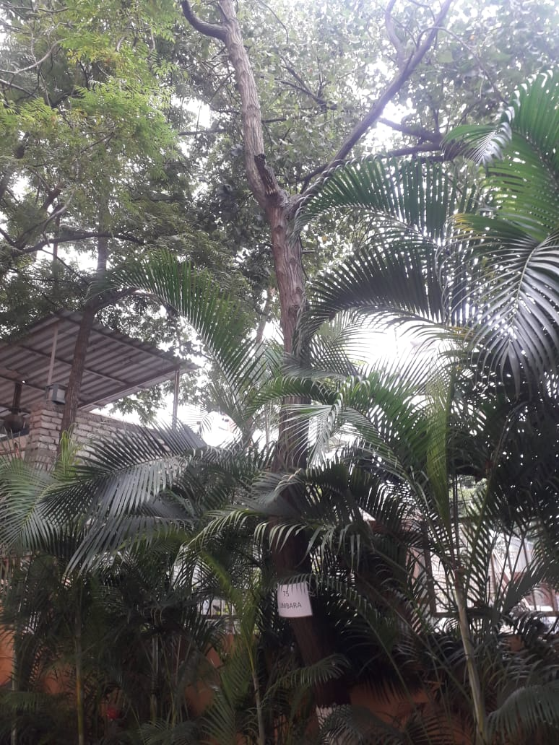
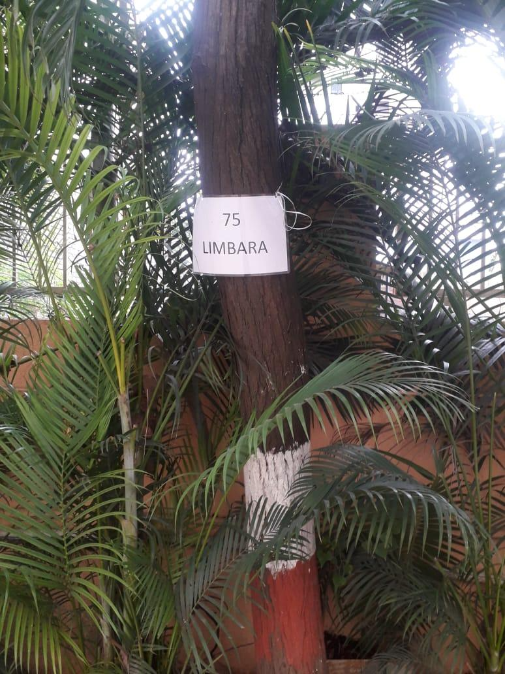
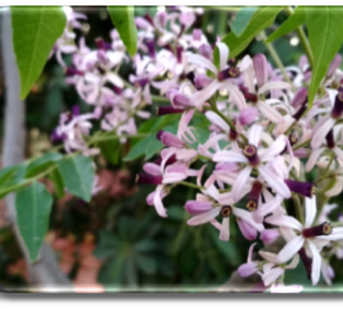
LIMBARA TREE
Near assembly point 3 to assembly point 2 and upto new bld. construction.AIS Campus, Wakad.

Slide 2
Common Name : Limbara, Mahaimb
Scientific Name : Melia azedarach
Family : Meliaceae.
Habit : Grows in tropical and subtropical regions. Mature trees can survive in
below 0˚ Celsius and above 40˚ Celsius temperatures.
Distribution : It was originally found in Southeast Asia and Northern Australia, It has
been introduced to many parts of the world and can be found naturalized
across the Americas, the Caribbean, the Mediterranean basins, the Middle
East, Asia, Africa and on many islands in the Pacific region.

Slide 3
Description :
Height of Tree : About 7-12 m (20-40 ft).
Leaves : The leaves are up to 50 centimetres (20 inches) long, alternate, long-petioled, two or three
times compound (odd-pinnate); the leaflets are dark green above and lighter green below, with
serrate margins.
Fruits: The fruit is a drupe, marble-sized, light yellow at maturity, hanging on the tree all winter, and
gradually becoming wrinkled and almost white.
Flowers: The flowers are small and fragrant, with five pale purple or lilac petals, growing in clusters.

Slide 4
Fruits: Chinaberry fruit was used to prevent insect larvae from growing in the fruit. By placing the berries in, for example, drying apples and keeping the fruit turned in the sun without damaging any of the chinaberry skin, the fruit will dry and will prevent insect larvae in the dried apples. The tre has a timber of high quality, but in comparison to many almost-extinct species of mahogany, it is under-utilised. Seasoning is relatively simple — planks dry without cracking or warping and are resistant to fungal infection.
Leaves: Leaves have been used as a natural insecticide to keep with stored food, but must not be eaten as they are highly poisonous.
Bark: The cut branches with mature fruit are sold commercially to the florist and landscaping trade particularly as a component for outdoor holiday décor.
Seeds: The tough five-grooved seeds were widely used for making rosaries and other products requiring beads; however, the seeds were later replaced by plastics.

